Slide 1
Logic Specification and Z Schema
3K04
McMaster

Slide 2
Basic Logic Operators
Logical negation ( ¬ )
Logical conjunction ( Λ or & )
Logical disjunction ( V or || )
Logical implication ( → )
Logical equality ( = or ↔ )

Slide 3

Logic Negation
NOT p (also written as ¬p)

Slide 4
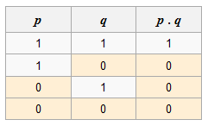
Logic Conjunction
p AND q (also written as p ∧ q, p & q, or p·q)

Slide 5
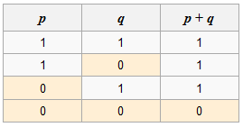
Logic Disjunction
p OR q (also written as p ∨ q or p + q)

Slide 6
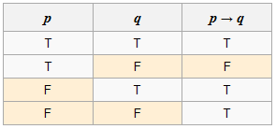
Logic Implication
p implies q (also written as p → q, not p or q)

Slide 7
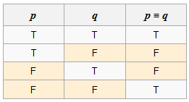
Logic Equality
p EQ q (also written as p = q, p ↔ q, or p ≡ q)

Slide 8
First-order logic
While propositional logic deals with simple declarative propositions, first-order logic additionally covers predicates and quantification.
Each interpretation of first-order logic includes a domain of discourse over which the quantifiers range.

Slide 9
Predicate
A predicate resembles a function that returns either True or False.
Consider the following sentences: "Socrates is a philosopher", "Plato is a philosopher".
In propositional logic these are treated as two unrelated propositions, denoted for example by p and q.
In first-order logic, however, the sentences can be expressed in a more parallel manner using the predicate Phil(a), which asserts that the object represented by a is a philosopher.

Slide 10
Quantifier
- universal quantifier; - existential quantifier
Let Phil(a) assert a is a philosopher and let Schol(a) assert that a is a scholar
For every a, if a is a philosopher then a is a scholar.
If a is a philosopher then a is a scholar.

Slide 11
Z notation
The Z notation, is a formal specification language used for describing and modeling computing systems.
It is targeted at the clear specification of computer programs and the formulation of proofs about the intended program behavior.

Slide 12
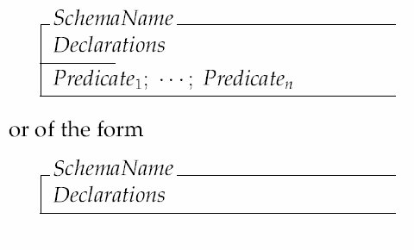
Z Schemas
The Z schema is a graphical notation for describing
  State spaces
  operations

Slide 13
The declarations part of the schema will contains:
  A list of variable declarations
  References to other schemas (schema inclusion)
The predicate part of a schema contains a list of predicates, separated either by semi-colons or new lines.

Slide 14
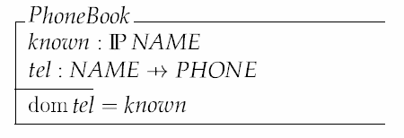
State Space Schemas
Here is an example state-space schema, representing part of a system that records details about the phone numbers of staff.
Assume that NAME is a set of names, and PHONE is a set of phone numbers.

Slide 15
Operation Schemas
In specifying a system operation, we must consider:
  The objects that are accessed by the operation;
  The pre-conditions of the operation, i.e., the things that must be true for the operation to succeed;
  The post-conditions, i.e., the things that will be true after the operation, if the pre-condition was satisfied before the operation.

Slide 16
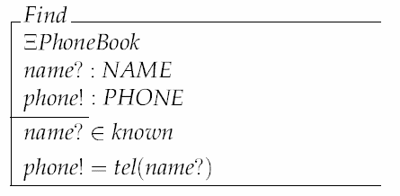
Consider the ‘lookup’ operation: input a name, output a phone number.
  This operation accesses the PhoneBook schema;
  It does not change it;
  It takes a single ‘input’, and produces a single output;
  Pre-condition: the name is known to the database.

Slide 17
This illustrates the following Z conventions:
  Placing the name of the schema in the declaration part ‘includes’ that schema;
  ‘input’ variable names are terminated by a question mark;
  ‘output’ variables are terminated by an exclamation mark;
  The (Xi) symbol means that the PhoneBook schema is not changed; if we write a Δ (delta) instead, it would mean that the PhoneBook schema did change.

Slide 18
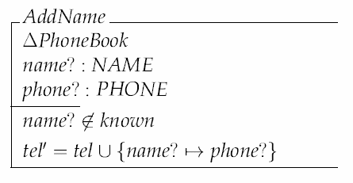
Add a name/phone pair to the phone book.
Appending a ‘ to a variable means “the variable after the operation is performed”.

Slide 19
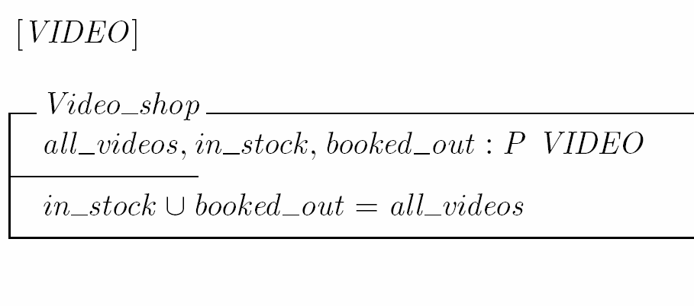
Example: Video Rental Shop

Slide 20
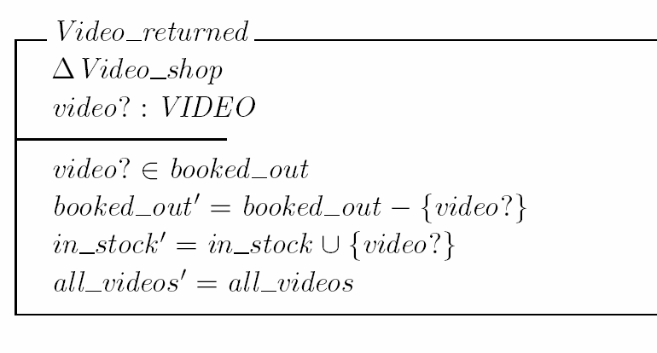
Returning a video

Slide 21
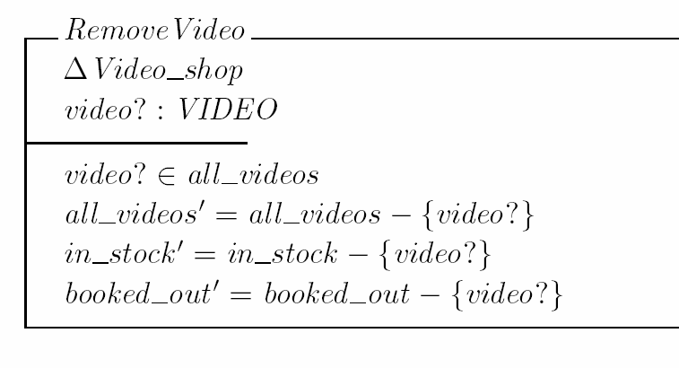
Removal of a video from the stock

Slide 22

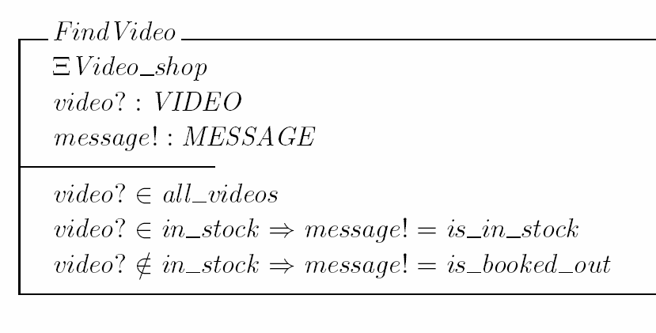
Find a video

Slide 23
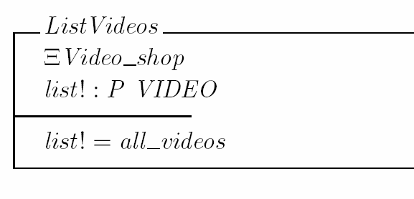
List all videos

Slide 24
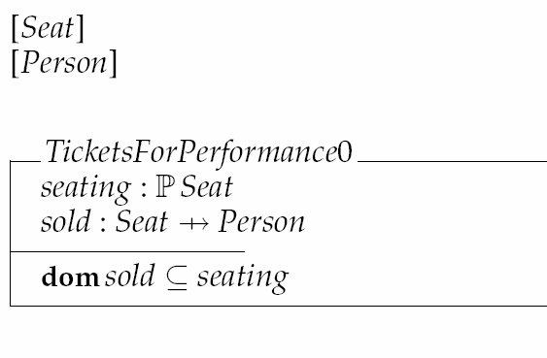
Example: Sale Theater tickets

Slide 25

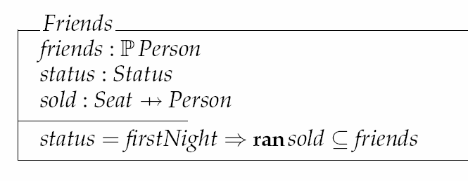
Informal specification
  Theater: Tickets for the first night are only sold to friends
Specification in Z

Slide 26
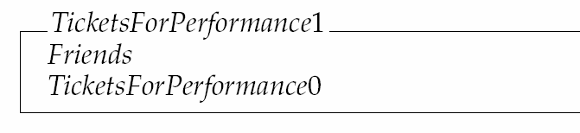
and

Slide 27
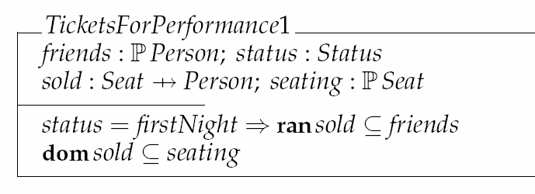
and
are the same as

Slide 28
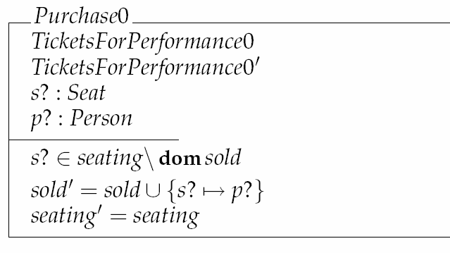
Selling tickets

Slide 29
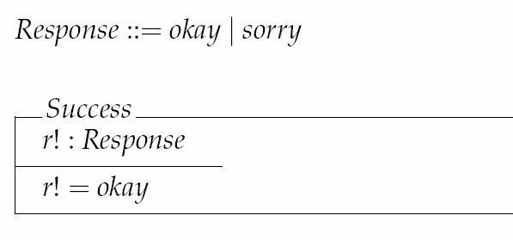

Then
is a schema that reports successful ticket sale.

Slide 30
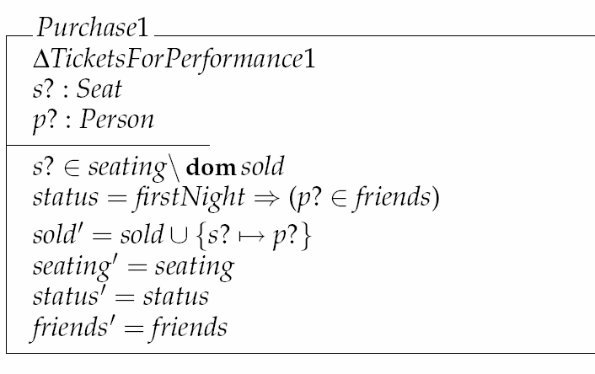
Selling tickets, but only to friends if first night performance

Slide 31
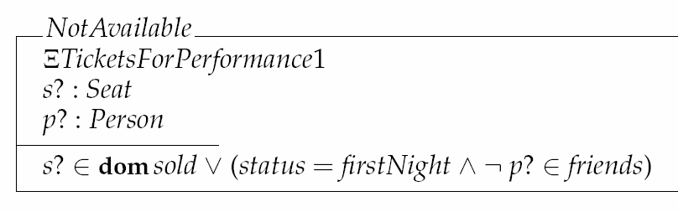
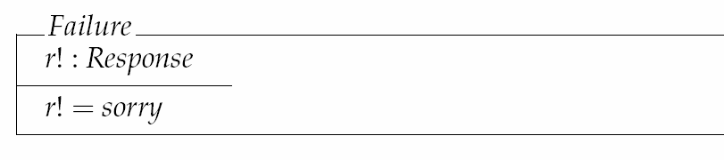
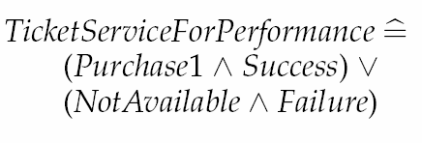

Slide 32

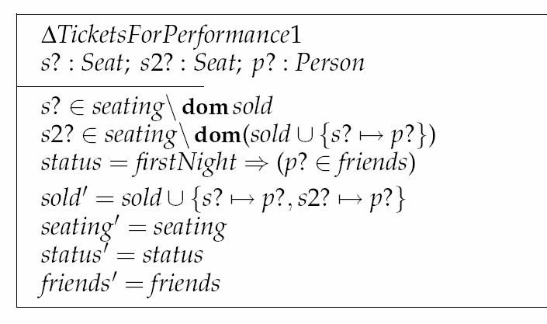
Composition of Operation Schemas
is equivalent to

Slide 33



Example: Order Invoicing

Slide 34
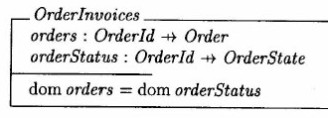
Order Invoices

Slide 35
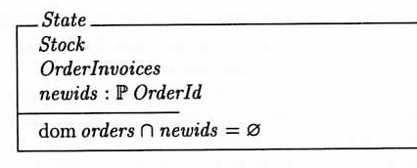
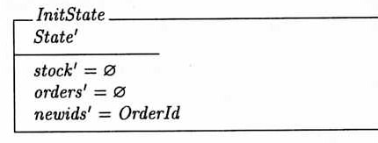
State

Slide 36
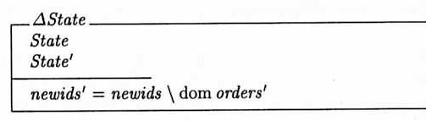
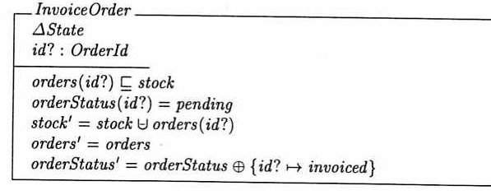
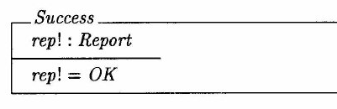

Slide 37
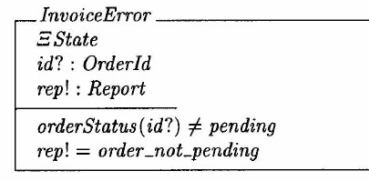
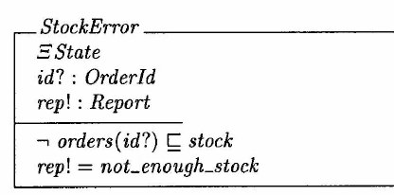

Slide 38


A total operation for ordering

